Slide 1
The Internet and Open Source
Monday, June 13, 2011

Slide 2
History of the Internet
http://www.youtube.com/watch?v=9hIQjrMHTv4

Slide 3
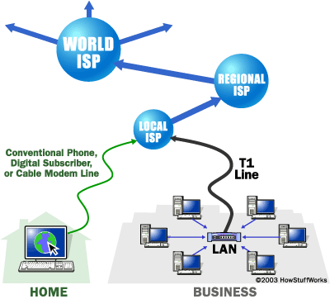
Notes:
Image:
http://static.howstuffworks.com/gif/webserver-backbone-sm.gif

Slide 4
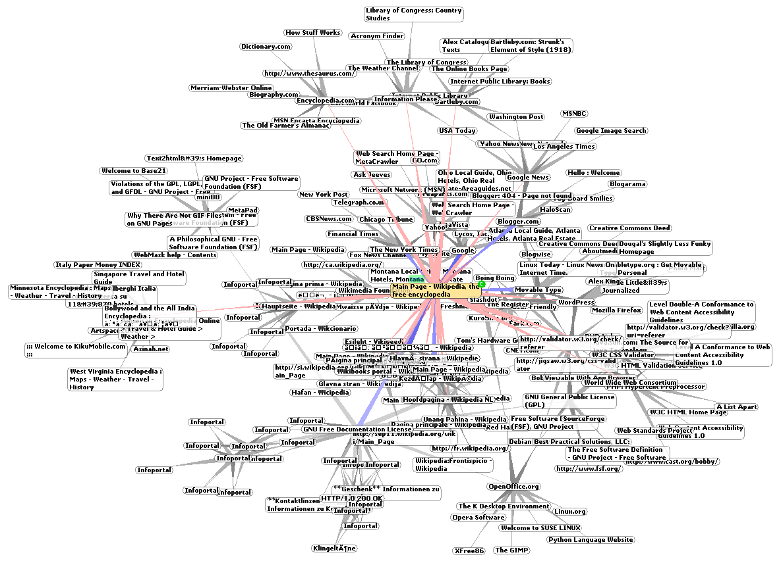
Notes:
- A picture of part of the Internet

Slide 5
The State of the Internet
http://www.youtube.com/watch?v=T6MfnuvH4Rs

Slide 6
Stuff To Do Online
News
Entertainment
Common-interest communities
Shopping
Banking

Slide 7
Stuff To Do Online
Advertising
Finding jobs and employees
Addresses, maps, phone numbers
Course notes, lectures, etc
Publications

Slide 8
Stuff To Do Online
Download software
Get software updates

Slide 9
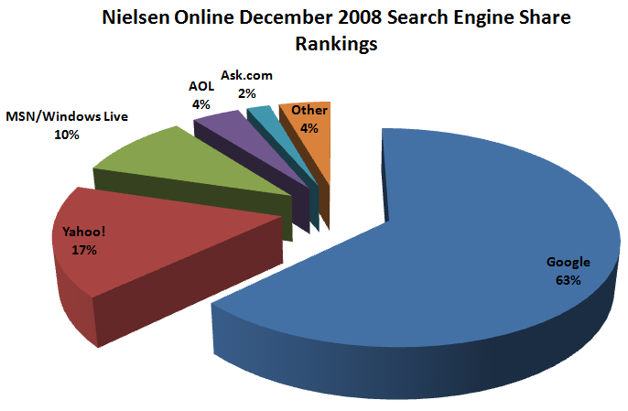

Slide 10
Deconstructing a URL
protocol
file or page to get
sub-domain
http://www.scs.carleton.ca/~courses/index.php
domain name
Notes:
URL:
Uniform Resource Locator
The address of hypertext / The location of a webpage

Slide 11
Advanced Google Searching
http://www.google.com/support/websearch/bin/answer.py?hl=en&answer=134479
Notes:
Start with this site, then move to the links on the left:
“More Search Help”
“Explore Search”
Lots of advanced ways to search Google

Slide 12
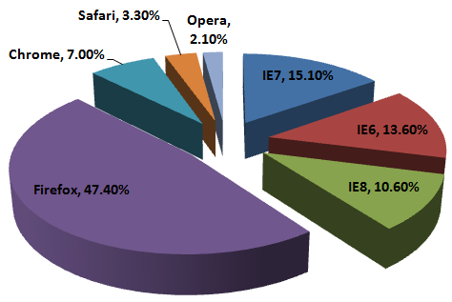
Browser Market Share (2009)
Notes:
Stats from
http://www.w3schools.com/browsers/browsers_stats.asp

Slide 13
Browser Tips (Know how to…)
Add/organize bookmarks
Install plug-ins/add-ons
Clear personal info
Search on a page
Use shortcuts

Slide 14
Netiquette
http://en.sevenload.com/shows/Tech-Gadgets/episodes/ZIwvGfc-How-To-Follow-Proper-Netiquette-Rules

Slide 15
Google Docs
http://docs.google.com/
Notes:
In class I will show the Docs functionality (but not talk about Spreadsheets or Presentations as much, since others did tutorials on them)
Key features like sharing and collaborative editing
Lots of help here:
http://docs.google.com/support/?hl=en

Slide 16
Google Groups
http://groups.google.com
Notes:
Basic Google Groups functionality
Especially useful for group projects, clubs, etc
Lots of help here
http://groups.google.com/support/?hl=en

Slide 17
Blogger
http://blogger.com/
Notes:
Set up a free blog, which includes an RSS feed
What the heck is RSS anyway?
http://en.wikipedia.org/wiki/RSS
Get updates on websites all in one place
Check out http://reader.google.com

Slide 18
Wikipedia Markup Language
http://en.wikipedia.org/wiki/Wikipedia:Cheatsheet
Notes:
- This is actually very similar to what’s found on many wiki sites (those that actually let you see the markup – some just have rich text editing)

Slide 19
Small HTML Example
<html>
<head>
<title>
A Minimal HTML Document
</title>
</head>
<body>
This paragraph is part of a simple HTML document
</body>
</html>
tells the browser that what
follows is HTML text
the section of the document that
contains the title (also extra
information about the document)
whatever you put between
the title tags appears in
the top of the browser
window
begins the body of the
document, the place where
the page's content goes
Notes:
We’ll also open up the HTML on a webpage and look at it
Do this with View, Source or something similar

Slide 20
Learn HTML Basics
http://www.w3schools.com/html/default.asp

Slide 21
Open Source Software
Notes:
Just a quickie before going on to in-class presentations.
Check out the detailed how-to slides for lots more on open source (including other examples of programs to try).

Slide 22
Notes:
Open source is all about freedom
Think free as in free speech, not free beer
“Open-source software (OSS) is computer software that is available in source code form for which the source code and certain other rights normally reserved for copyright holders are provided under a software license that permits users to study, change, and improve the software.”
http://en.wikipedia.org/wiki/Open-source_software
Discussion on how OSS is made, who makes it…

Slide 23
One License: Creative Commons
http://www.youtube.com/watch?v=io3BrAQl3so
Notes:
There are several different kinds of licenses that dictate what you can and cannot do

Slide 24
What are the pros/cons of open source software?
Think in small groups
Discuss with class

Slide 25
Some Useful Open Source Software
Linux
GIMP
Inkscape
Blender
Audacity
VLC
Open Office
Notes:
Many more here:
http://en.wikipedia.org/wiki/List_of_free_and_open_source_software_packages

