Slide 1
Usability Evaluation
June 8, 2011

Slide 2
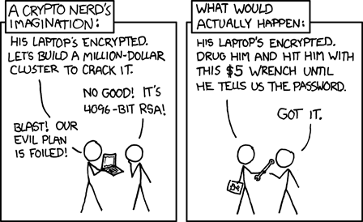
Why do we need to do usability evaluation?

Slide 3
Types of Usability Evaluation
Inspection methods
Heuristic Evaluation
Cognitive Walkthroughs
Usability studies
User studies
Field studies

Slide 4
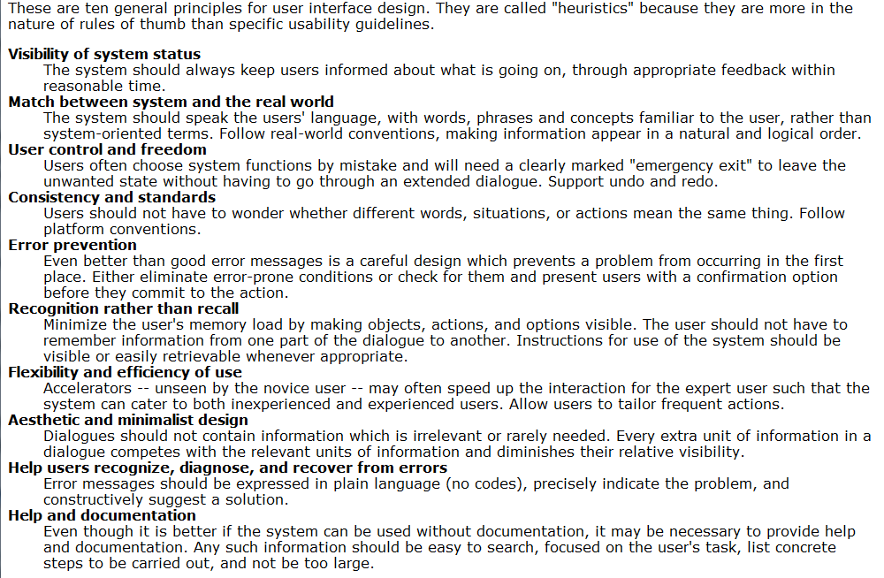
Heuristic Evaluation
Using a set of usability principles (heuristics) to evaluate a system’s user-interface elements
Heuristics are pre-determined, and can be domain-specific
Heuristic evaluation is performed by a small number of expert evaluators
3-5 evaluators needed
Typically, they can find ~75% of usability errors

Slide 5
Nielsen’s Heuristics
Visibility of system status
The system should tell the user what is going on
Match between system and real world
Present information similarly to how it would appear in the real world
User control and freedom
Support undo and redo functions so that users can experiment
Consistency and standards
Be consistent so that users don’t have to figure it out every time
Notes:
Here for exposure, no need to memorize

Slide 6
Nielsen’s Heuristics (cont.)
Error prevention
Alert users before they make irreversible decisions
Recognition rather than recall
Make objects, actions, options visible
Flexibility and efficiency of use
Provide options that increase efficiency for expert users
Make shortcuts for commonly completed tasks
Aesthetic and minimalist design
Stick to the relevant information, keep it uncluttered

Slide 7
Nielsen’s Heuristics (cont.)
Help users recognize, diagnose and recover from errors
Error messages should be understandable
Help and documentation
Provide appropriate documentation for when its needed

Slide 8
Heuristic Evaluation Activity
In small groups, perform an heuristic evaluation of the website pictured on the next slide.
Write down potential usability problems
Note the heuristic they’re breaking
Rate the problem:
1 – minor problem
2 – potential problem
3 – showstopper

Slide 9
SIPhawaii.com

Slide 10
Cognitive Walkthroughs
Simulating the user’s problem-solving process to discover usability problems
Useful to identify specific problems with a lot of detail
Focus is on how the user would learn to use the system
Performed by the designer and at least one expert evaluator

Slide 11
Steps for a Cognitive Walkthrough
Identify the typical user and sample tasks
Create a clear sequence of actions needed to complete each task
Evaluators walk through the action sequence for each task, asking questions about the user at each step
Will the user know what to do?
Will the user see how to do it?
Will the user understand whether they did the right thing?
Record observations, problems, causes, suggested fixes

Slide 12
Cognitive Walkthrough Activity
Get out your cell phone
Go through the task sequence to add a new contact to the address book
Perform a cognitive walkthrough, focusing on how a user would learn the process
Evaluate items such as menus, options, and user interface elements you experience
Record any possible usability problems, and categorize them as:
1 – minor problem
2 – potential problem
3 – showstopper

Slide 13
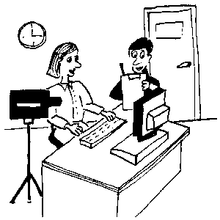
User Studies
A lab study where real users are observed using the product and the usability of the product or system is measured
Observations can be quantitative:
Number of errors
Time to complete a task
Or qualitative:
Does the user enjoy using the system?

Slide 14
User Studies (cont.)
Data-gathering techniques include:
Video-recordings
Think-aloud procedures
Interviews
Questionnaires
5-12 users can be sufficient to get a complete picture of the usability of the system
Less for quick feedback situations
More for statistical comparisons

Slide 15
Running a User Study
Usability lab
Special equipment?
Designated space?
Participants
How to recruit?
Tasks & procedure
All participants should receive the same information
Ethics Review
Tests with human participants need to conform to ethical standards

Slide 16
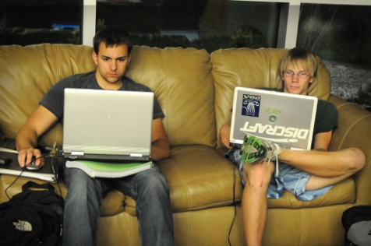
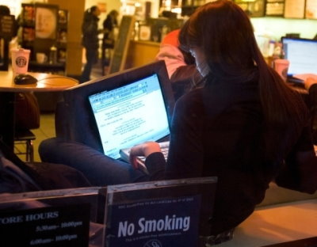
Field studies
User studies that take place in natural settings
Less controlled study
Better ecological validity
better understanding of how people actually use the product
Often difficult to plan and run

Slide 17
User Study Example
Website Usability Study
Investigating the usability of several websites as well as the usability of passwords in the context of website use
Week-long study, paying $20
3 sessions, less than 2 hours in total
Want to participate?
Email carletonHCIstudy@gmail.com

