Slide 1
Sorting Algorithms
Wednesday, June 1, 2011

Slide 2
How do you sort when you can only compare two things?
Notes:
Image:
http://images3.wikia.nocookie.net/soulcalibur/images/9/93/Height_Comparison.jpg
Computers only compare two things at a time, show how do they sort efficiently?

Slide 3
Sorting Demo
http://gailcarmichael.com/processing/bottlesort/
Notes:
Note that the size of the bottles does NOT indicate how light they are. They all have very different substances inside that can weight different amounts.

Slide 4
Sort
Part One:
Find the lightest bottle using the scale
What is the easiest way to do this?

Slide 5
Sort
Part Two:
Choose three bottles at random
Sort them using the scale
What is the fewest number of comparisons you can do?

Slide 6
Sort
Part Three:
Sort all the bottles from lightest to heaviest by repeatedly finding the lightest bottle that’s left, and moving it into the sorted list at the top
This is known as Selection Sort

Slide 7
Selection Sort Dance
http://www.youtube.com/watch?v=Ns4TPTC8whw

Slide 8
Selection Sort Demo
http://www.sorting-algorithms.com/selection-sort

Slide 9
Selection Sort Demo (II)
http://www.cosc.canterbury.ac.nz/mukundan/dsal/SSort.html

Slide 10
Insertion Sort
Take the next item in the unsorted list
Insert it into the correct location in the sorted list
Do this by comparing the new item with each of the existing items until the correct place is found

Slide 11
Insertion Sort Dance
http://www.youtube.com/watch?v=ROalU379l3U

Slide 12
Insertion Sort Demo
http://www.sorting-algorithms.com/insertion-sort

Slide 13
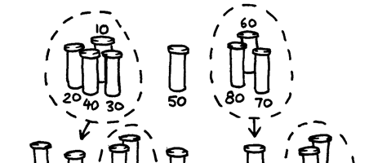
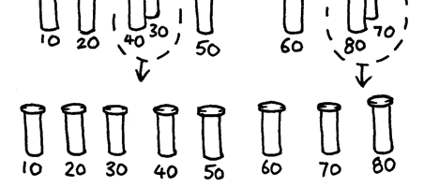
Quick Sort
Notes:
Pick a bottle at random and have them stand in front of the others
This is your pivot
Go through the rest of the group, and compare them with your pivot
Put lighter bottles on one side, heavier bottles on the other
Leave your pivot alone, and pick one of the groups on the left or the right
Repeat the whole thing with that group – that is, find a pivot, move lighter bottles to the left, heavier bottles to the right
Be sure to keep this entire group on the same side as the original pivot as you are sorting it
Keep doing this for every group that has more than one item.

Slide 14
Quick Sort Demo
http://www.sorting-algorithms.com/quick-sort

Slide 15
Quicksort Demo (II)
http://www.cosc.canterbury.ac.nz/mukundan/dsal/QSort.html

Slide 16
Quicksorting a Stack of Graded Papers
http://www.youtube.com/watch?v=FSyr8o8jjwM

Slide 17
Efficiency
Which sorting algorithm should be fastest in most cases?
What would happen to quicksort if you picked the lightest bottle to arrange around each time?

Slide 18
Selection Sort vs. Quicksort
http://www.youtube.com/watch?v=cVMKXKoGu_Y

